Slide 1

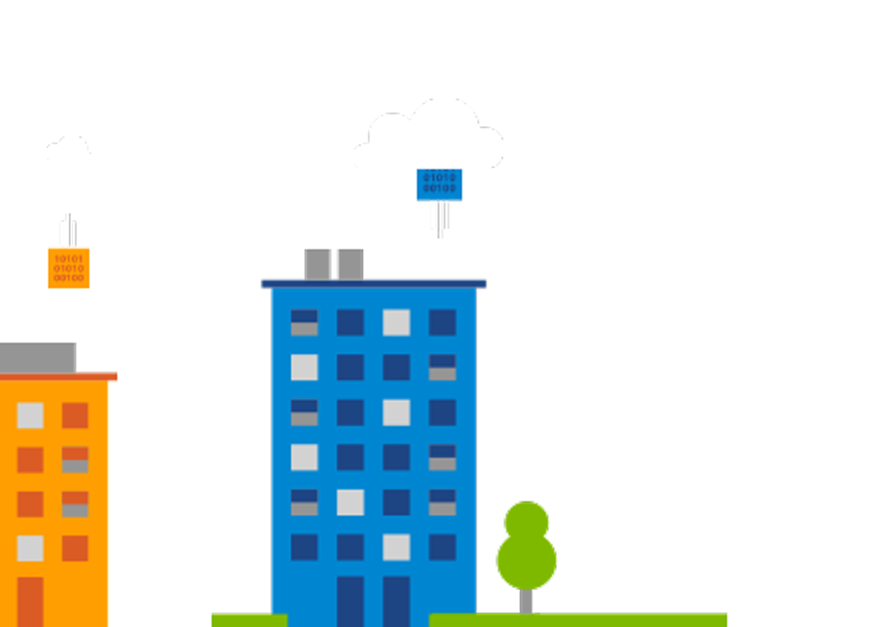
Smith Mangmeetakun
smithm@microsoft.com
+66818062332
Microsoft Azure Operational Management Suite
Bootcamp
Notes:
Today we are going to talk about StorSimple and hybrid cloud storage – and in particular – about the newest developments with this technology called Microsoft Azure StorSimple, which takes the integration of cloud services and on-premises storage to new levels.

Slide 2
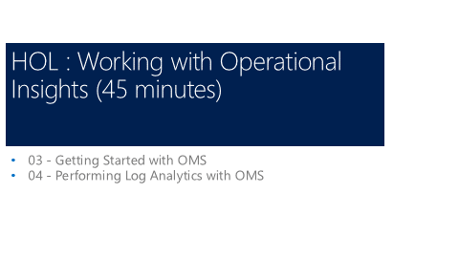

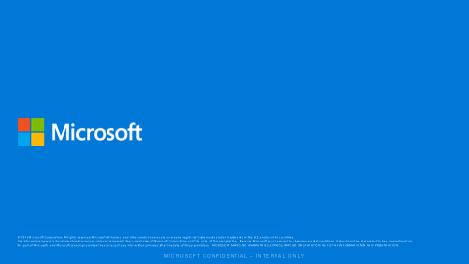
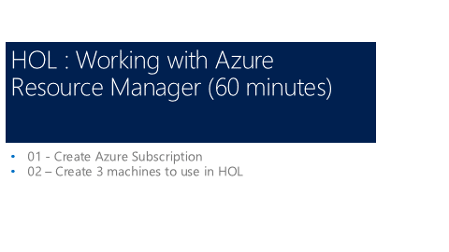
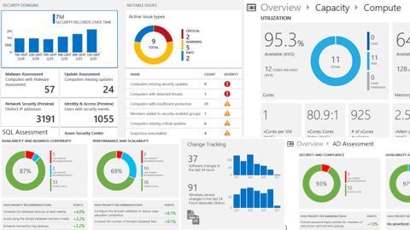
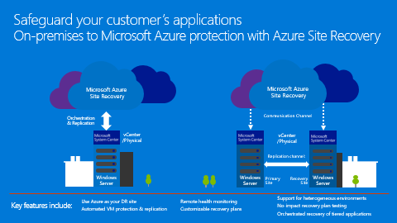
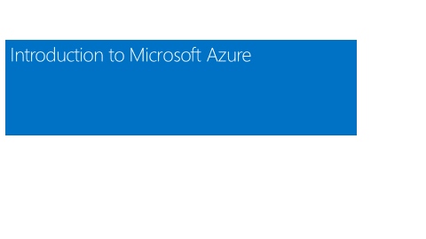
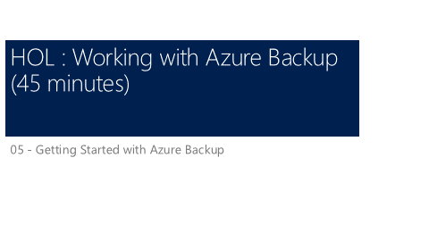
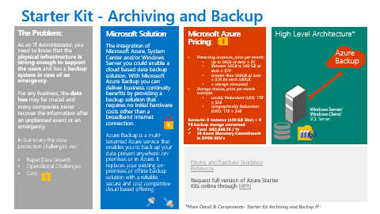
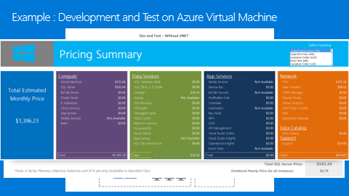
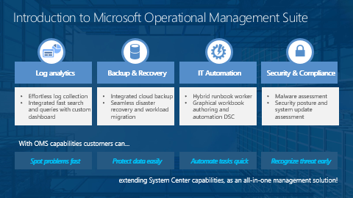
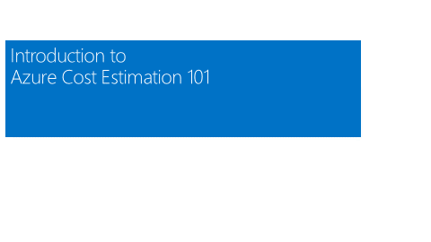
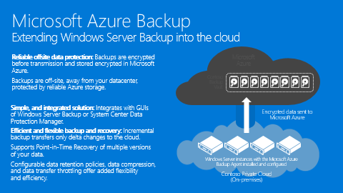
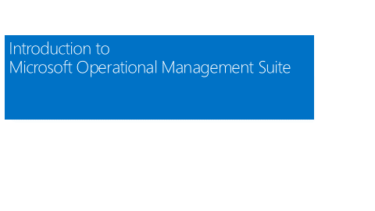
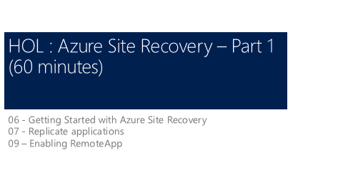
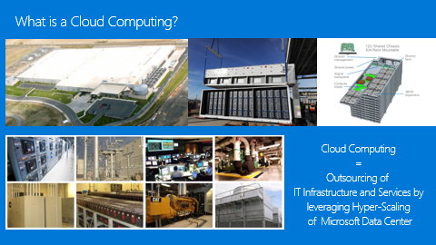
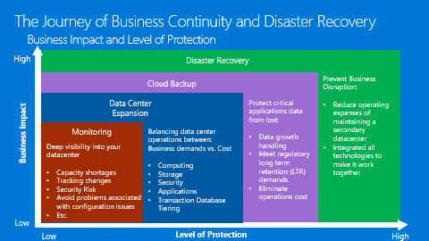
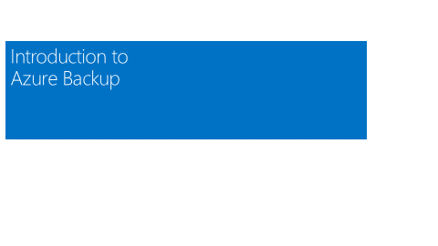
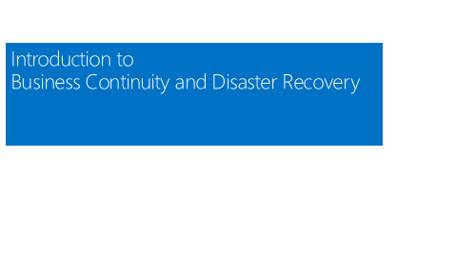
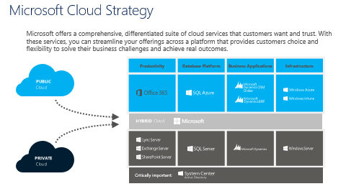

Slide 3
Pre-Class Activities
Connect your laptop to ssid: MSFTOPEN
Note: Please help us save bandwidth for the class by DO NOT CONNECT your phone to wireless
Download Class resources http://aka.ms/omshol Extract files and review class content - Azure OMS Bootcamp.pptx - OMS Hands-On Labs.pptx - \Starter Kit - Azure Site Recovery - Get Azure Pass from Instructor

Slide 4
Class Objective
Understanding Microsoft Azure Business Continuity / Disaster Recovery Components
Ability to provides customer consultant on basic components to develop
Ability to conduct simple version of Azure BCDR POC
Pass Requirements Check-Point / Examination

Slide 5
Agenda
Day 1
Introduction to Microsoft Azure (75 minutes)
Break
HOL : Working with Azure Resource Manager (60 minutes)
Lunch
Introduction to Microsoft Operational Management Suite (90 minutes)
Break
HOL : Working with Operational Insights (45 minutes)
Introduction to Azure Backup (30 minutes)
HOL : Working with Azure Backup (45 minutes)
Day 2
Introduction to Azure Site Recovery (75 minutes)
Break
HOL : Azure Site Recovery – Part 1 (60 minutes)
Lunch
HOL: Azure Site Recovery – Part 2 (90 minutes)
Break
Working with Azure Starter Kits (60 minutes)
Post Bootcamp Examination

Slide 6
Agenda – Day 1
Introduction to Microsoft Azure (75 minutes)
Microsoft Azure Concepts
Basic Azure Pricing
Break
HOL : Working with Azure Resource Manager (60 minutes)
Working with Azure Pass
Creating Virtual Machine on ARM
xxxASRHOLPS
xxxASRHOLApp
xxxASRHOLFile
Lunch
Introduction to Microsoft Operational Management Suite (90 minutes)
Introduction to Business Continuity and Disaster Recovery
OMS Components
asdf
Break
HOL : Working with Operational Insights (45 minutes)
Create Operational Insights Services
Download and Install Agent
Working with Operational Insights Dashboard
Introduction to Azure Backup (30 minutes)
HOL : Working with Azure Backup (45 minutes)
Create Azure Backup Vault
Enabling Azure Backup on xxxASRHOLFile

Slide 7
Introduction to Microsoft Azure

Slide 8

Microsoft Cloud Strategy
Microsoft offers a comprehensive, differentiated suite of cloud services that customers want and trust. With these services, you can streamline your offerings across a platform that provides customers choice and flexibility to solve their business challenges and achieve real outcomes.
Productivity | Database Platform | Business Applications | Infrastructure
PUBLIC
Cloud
Cloud
HYBRID
PRIVATE
Cloud
Critically important:

Slide 9
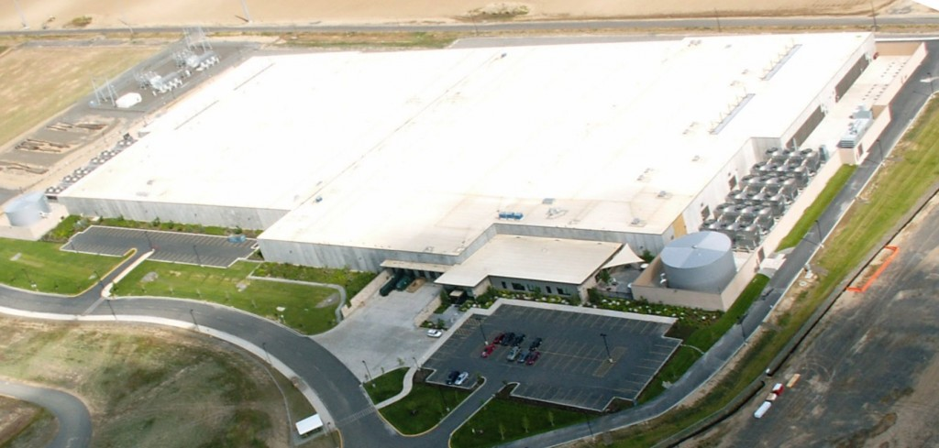
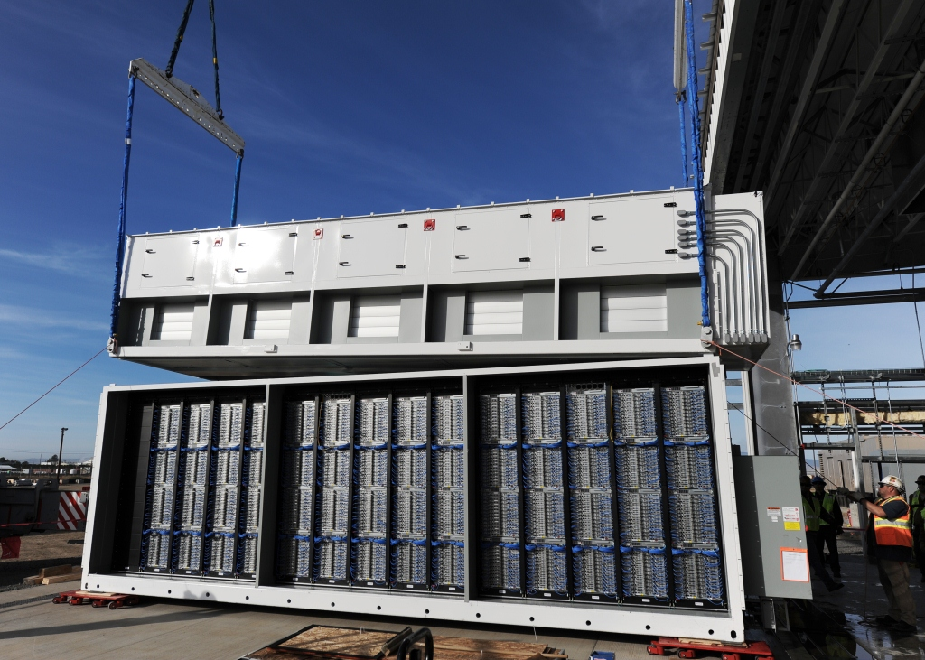
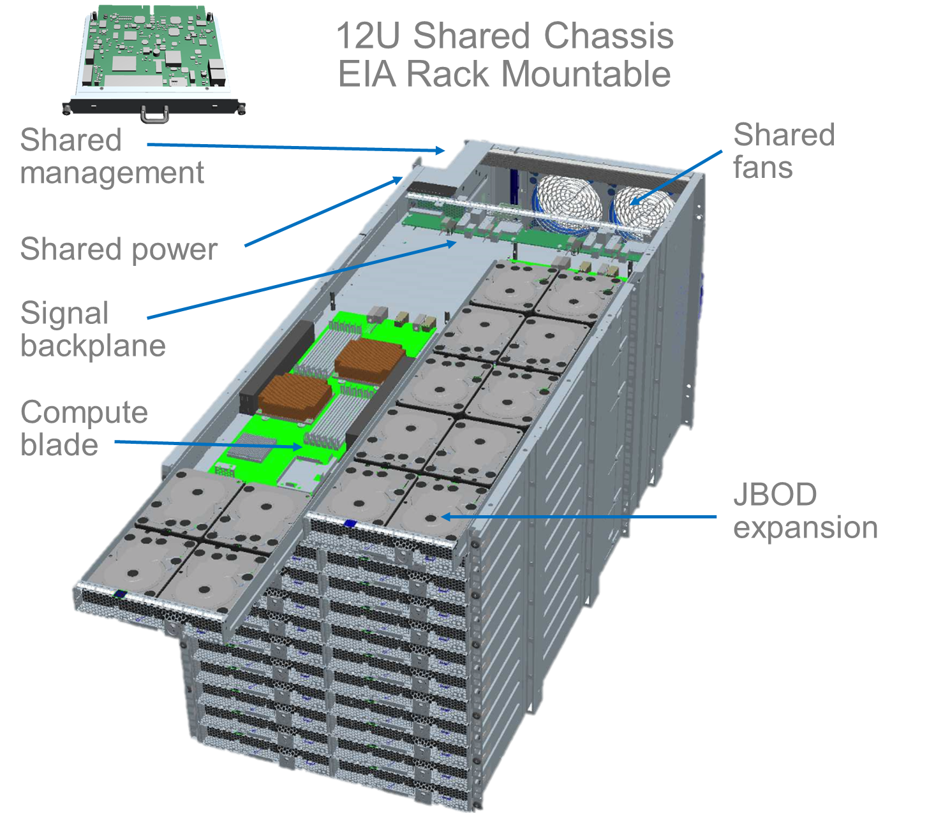
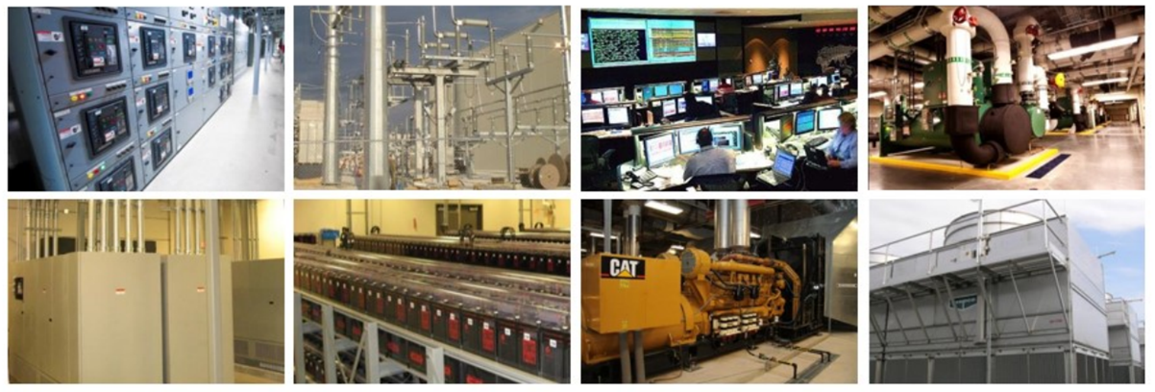
What is a Cloud Computing?
Cloud Computing
=
Outsourcing of
IT Infrastructure and Services by
leveraging Hyper-Scaling
of Microsoft Data Center

Slide 10

34
Azure regions

Slide 11

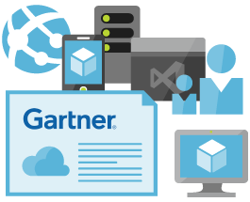
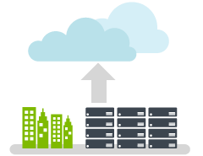


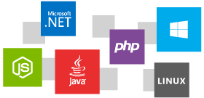
Introduction to Microsoft Azure The cloud for modern business
Make smarter decisions with predictive analytics services, including Machine Learning, Cortana Analytics and Stream Analytics, are redefining business intelligence
Extend your existing IT easily integrates with your existing IT environment with hybrid capabilities.
Get more done using skills you already have and technologies you already know
Rely on a trusted cloud service an industry-leading commitment to the protection and privacy of your data
Scale as you need, pay as you go.
Use an open and flexible cloud service platformใ

Slide 12





















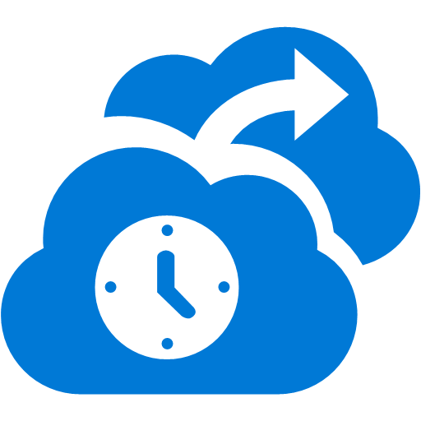









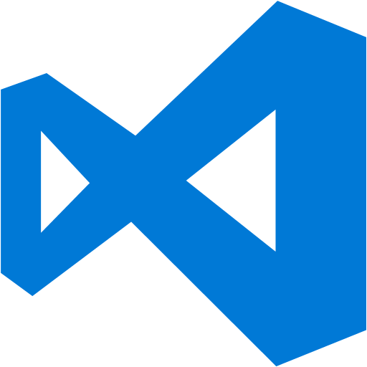



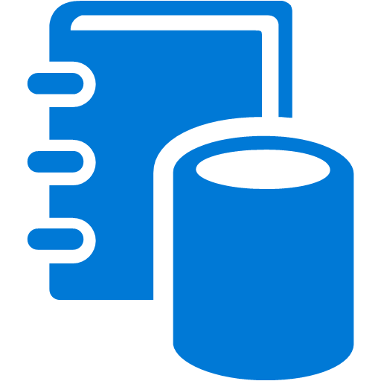

















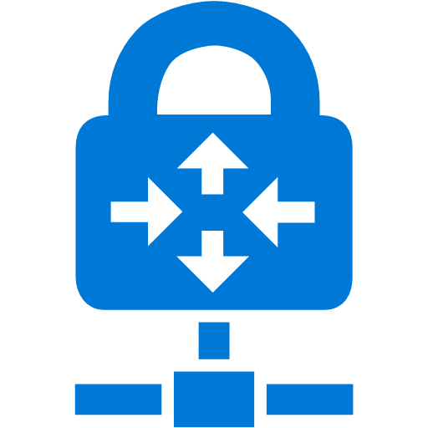

Platform Services
Security & Management
Services Compute
Web and Mobile
Data
Hybrid
Operations
Cloud
Services
Service
Fabric
Web Apps
API Apps
Portal
SQL
Database
Data
Warehouse
DocumentDB
Azure AD
Health Monitoring
Azure Active
Directory
Batch
RemoteApp
AD Privileged
Identity
Management
Mobile
Apps
Logic Apps
Redis
Cache
Azure
Search
Storage
Tables
Azure AD
B2C
Integration
Domain Services
Multi-Factor
Authentication
API
Management
Notification
Hubs
Analytics & IoT
Storage
Queues
BizTalk
Services
Backup
Automation
Hybrid
Connections
Service Bus
Developer Services
HDInsight
Machine
Learning
Stream
Analytics
Data
Lake
Operational
Analytics
Scheduler
Key Vault
Visual Studio
Azure
SDK
Data
Factory
Event
Hubs
Data
Catalog
Import/Export
Media & CDN
Store/
Marketplace
Media Services
Content Delivery
Network (CDN)
VS Online
App
Insights
Mobile
Engagement
Azure Site
Recovery
IoT Hub
VM Image Gallery
& VM Depot
StorSimple
Infrastructure Services
OS/Server Compute
Storage
Networking
Virtual Machines
Container
Service
BLOB Storage
Azure
Files
Premium
Storage
Virtual Network
Load Balancer
DNS
Express
Route
Traffic Manager
VPN Gateway
App
Gateway
Datacenter Infrastructure (28 Regions)

Slide 13

Microsoft Hybrid-Cloud Technologies
Data
Data Backup on Cloud
Backup
Collaborations
Business Productivity on Cloud
Office 365 / CRM
Business Continuity
By Microsoft Azure
Zero initial investment cost
Pay per use model
End-to-End protection
Co-existing with your datacenter
Applications
Disaster Recovery on Cloud
Site Recovery
Database
Hybrid-Cloud Database
SQL Hybrid
Identity
Hybrid-Cloud Identity
Azure AD
Virtualization
Software defined Computing
Resource Manager
Config Mgmt.
Mobile device management
InTune
Storage
Simplifies traditional Storage
StorSimple
Security
Ecosystem of security solutions
Security Center / ATA
Monitoring
Logs & Healthy report
Operational Insight
Networking
Software defined Networking
VNET / NSG
On Premises
Azure

Slide 14
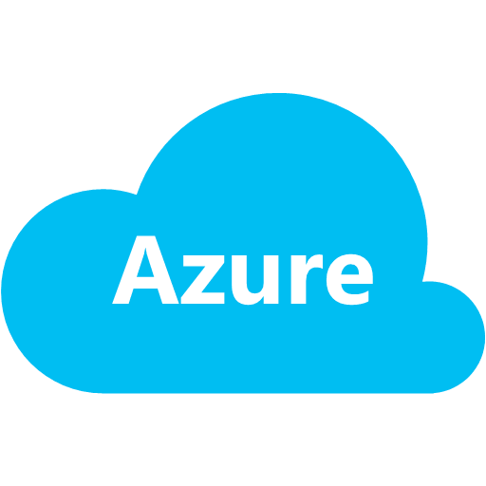


Microsoft Azure Hybrid-Cloud Technologies
NETWORKING & AUTOMATION SERVICES
Virtual network
Availability Set
Azure load balancer
Auto-scale
Traffic Manager
Automation
CDN
COMPUTE SERVICES
DATA SERVICES
On Premises Private Cloud
Health Monitoring
Automation
Virtual Machines
Azure Mobile Services
TFS or
VS Online + GIT
storage blob
storage table
storage queue
APPLICATIONS &
SERVICES
Site-to-Site VPN
Point-to-Site VPN
Active
Directory
Exchange
File Server
JEE App
.NET App
StorSimple
Cloud Integrated Storage
Azure Web Site
web roles
worker roles
VHD
VHD data disk
Gallery
OS images
LOB App
Commercial
App
SQL
My SQL
Oracle
Express Route
APP SERVICES
VIRTUALIZATION
COMPUTE,
STORAGE & NETWORKING
StorSimple
Virtual Appliance
Backup Service
Azure Site Recovery
Server Group #1
Server Group #2
System Center 2012 R2
Azure
AD
Multi-Factor Auth
Azure Cache
Storage Spaces/SMB
Provisioning
Access Control
BizTalk Services
Media Services
SQL
Database
SQL Data Sync
MySQL
database
SAN
Monitoring
DEVICES & FACILITIES
Automation & Self Service
Application Insight
Physical Infrastructure (Servers/Storage/Networking
IT Service Management
Service Bus
Notification Hub
Scheduler
HDInsight (Hadoop)
* Not meant to be a comprehensive list of all services, for a complete list please visit azure.microsoft.com

Slide 15
Introduction to Azure Cost Estimation 101

Slide 16
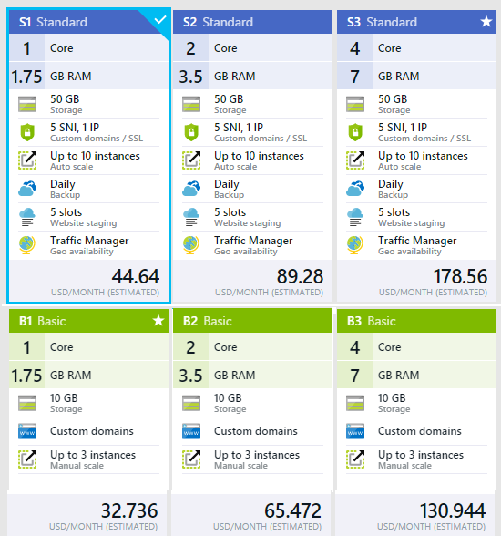
Azure Cost Estimation 101
Compute Services (per VM family / hour) +
Data Services (per GB and per Transaction) +
Network Services (outbound per GB) +
Additional Services (per Services)
=
Total Cost $ per Month

Slide 17
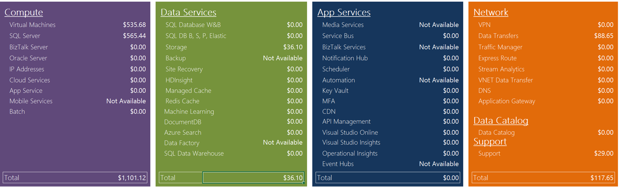
Azure Cost Estimation 101 - Example

Slide 18
Compute Services – Virtual Machines
A
D
DV2
G
N
Lowest Price
SSD Storage Fast CPUs
>80,000 IOPs
Premium Storage
New generation of D family VMs
Most memory fastest CPUs
GPU-enabled virtual machines
35% faster than D
Intel E5-2673 v3 CPUs
NVIDIA GPUs
Remote visualization
Compute-intensive + RDMA

Slide 19
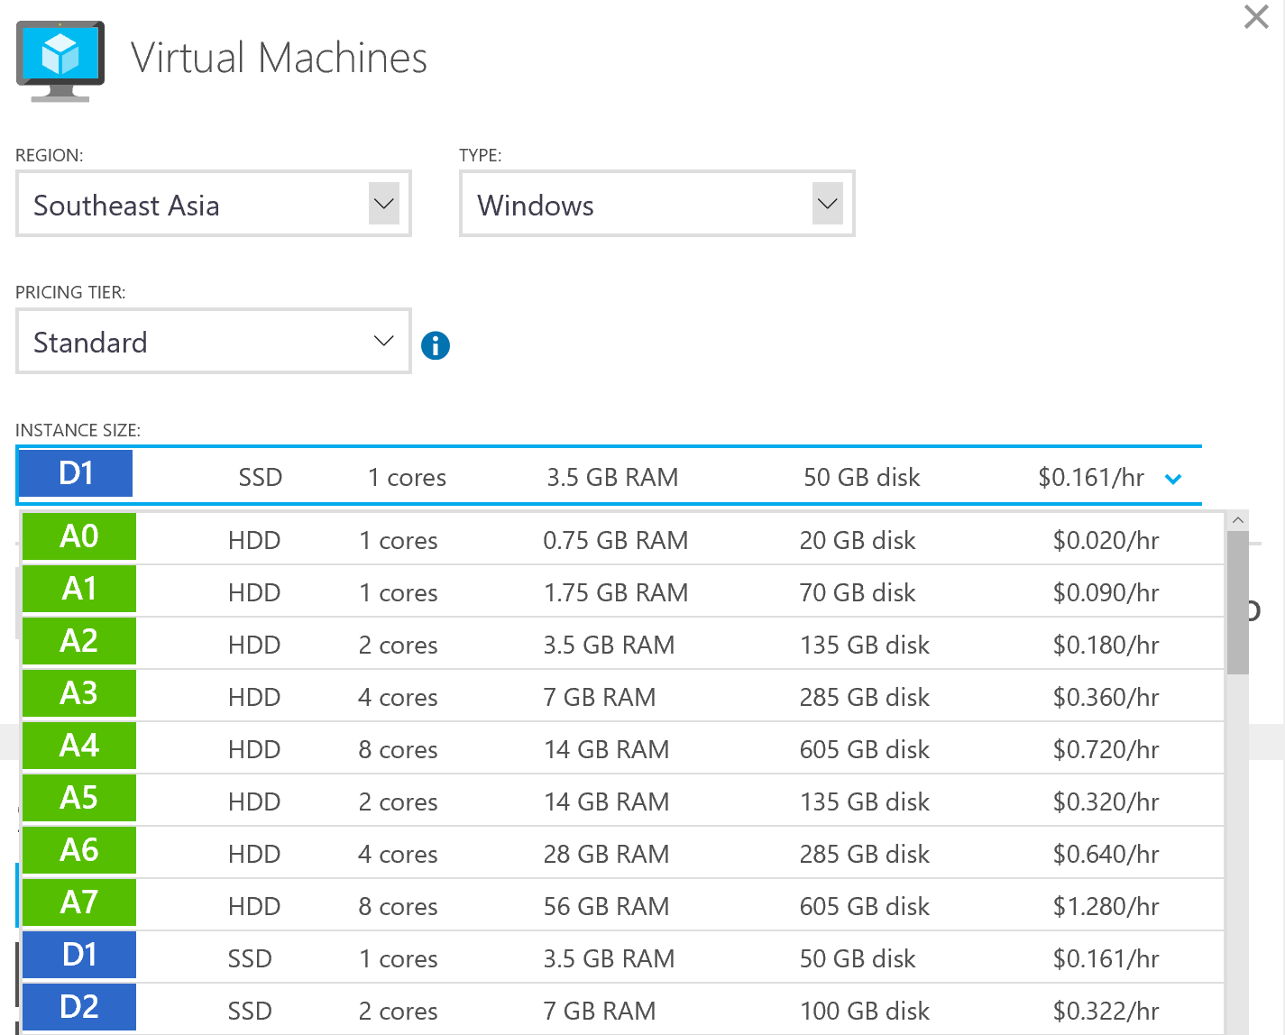
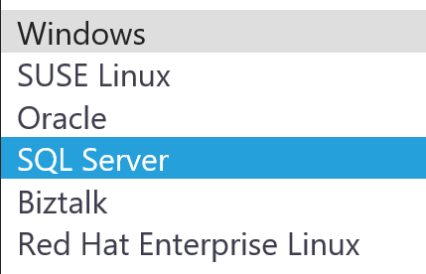
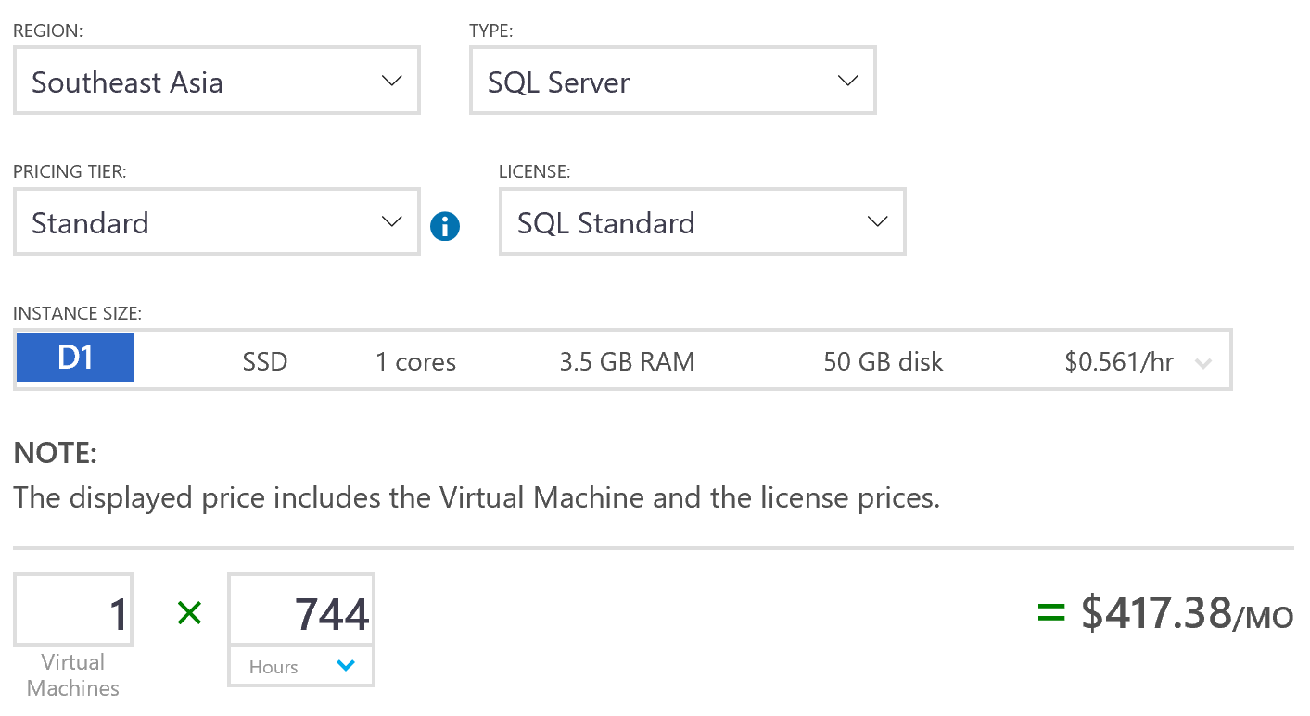
Virtual Machine Pricing Calculator

Slide 20
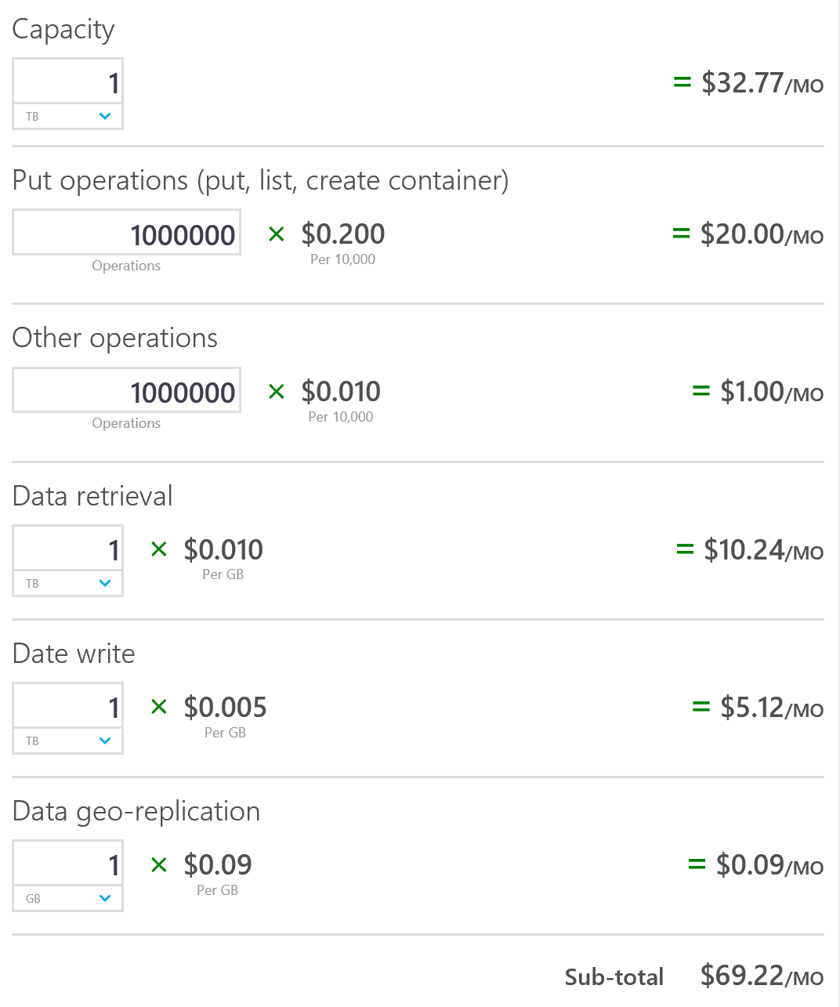
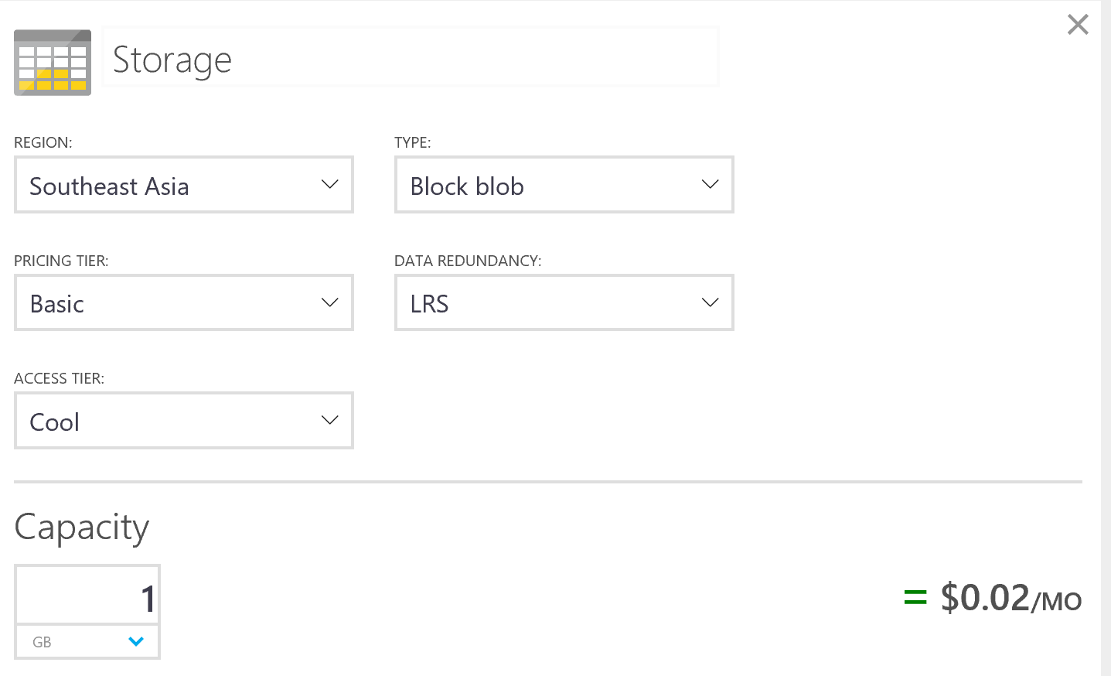
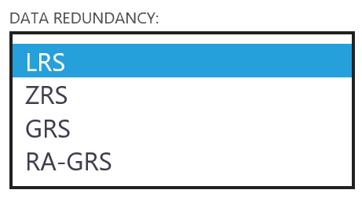
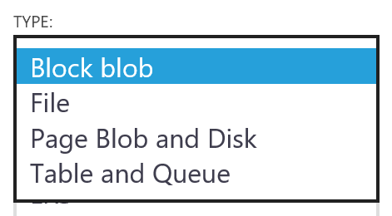
Data Services – Data & Storage

Slide 21
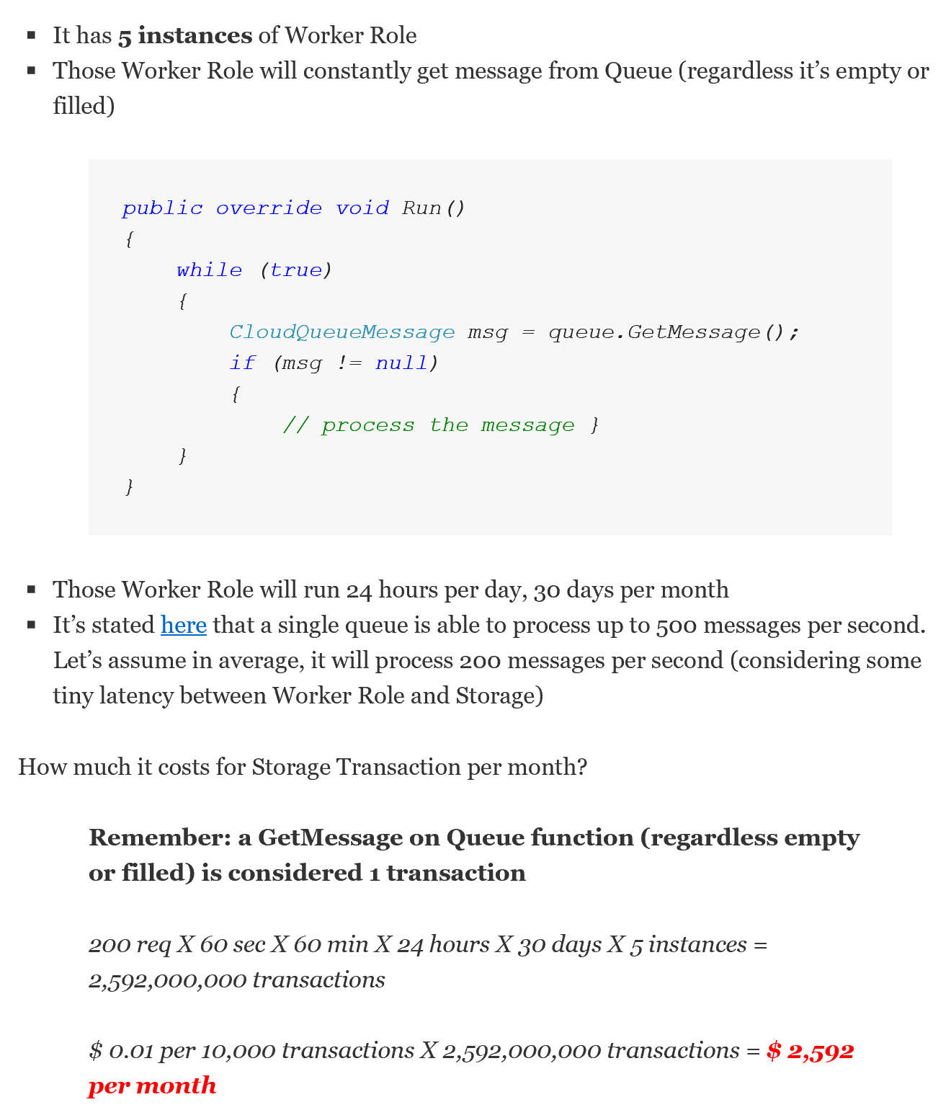
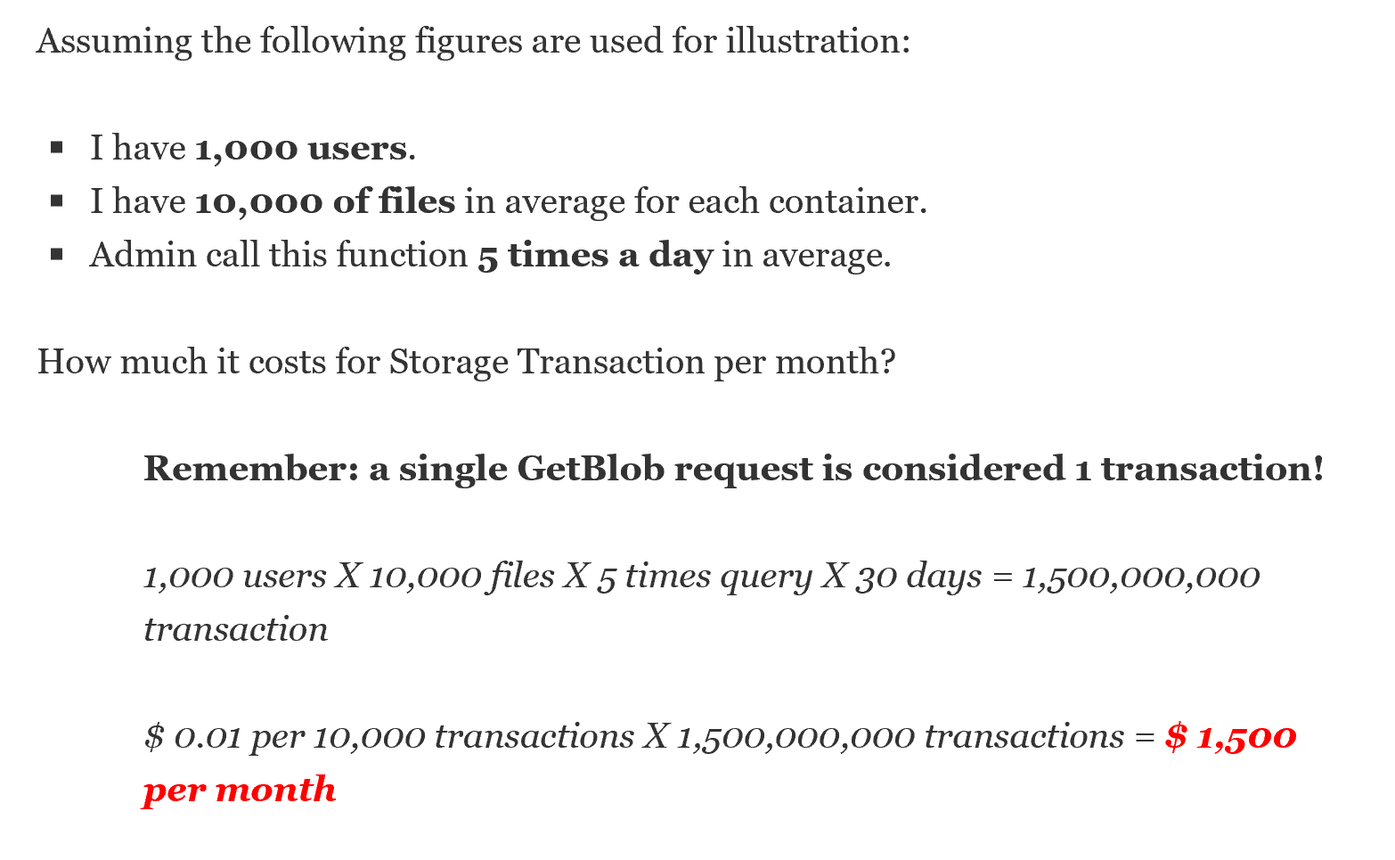
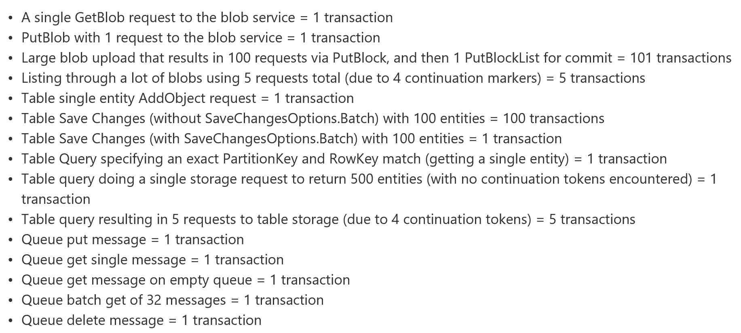
Storage Transactions - Example
Notes:
http://wely-lau.net/2011/12/02/unveiling-the-unforeseen-cost-of-windows-azure-storage-transaction/

Slide 22
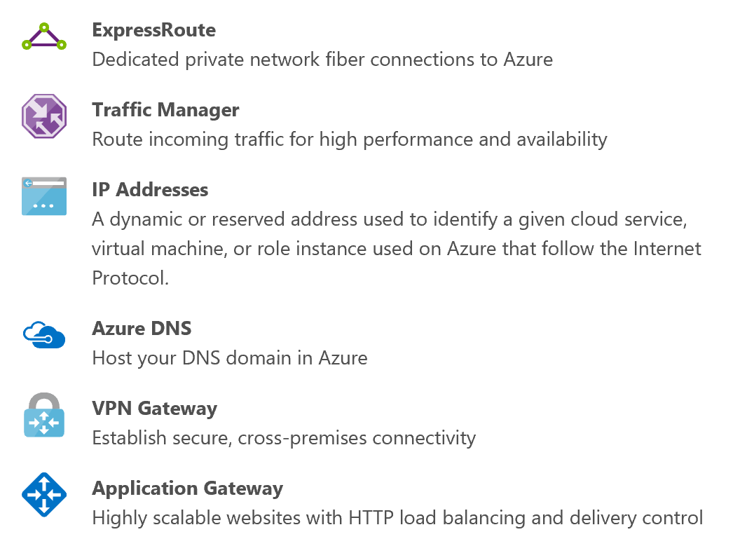
Network Services

Slide 23
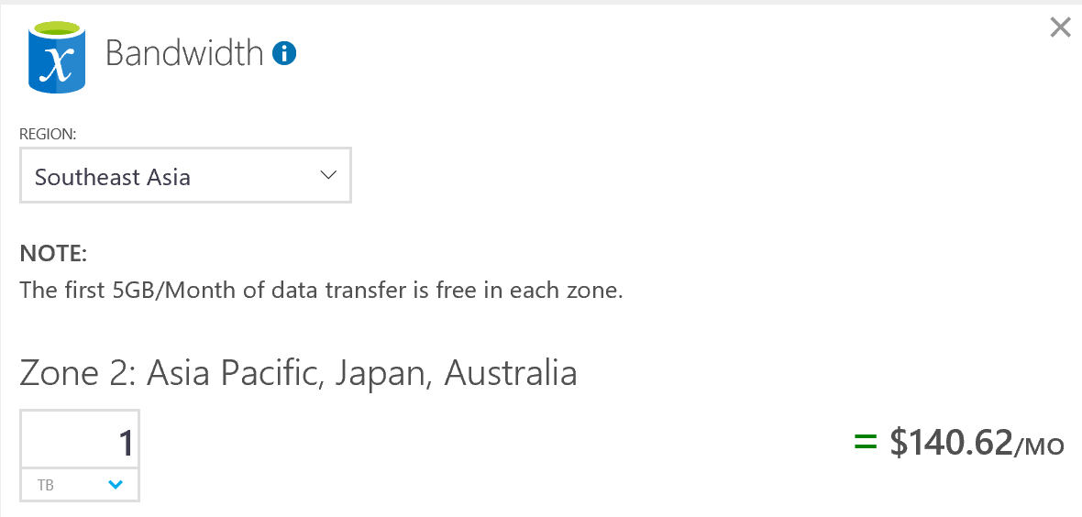
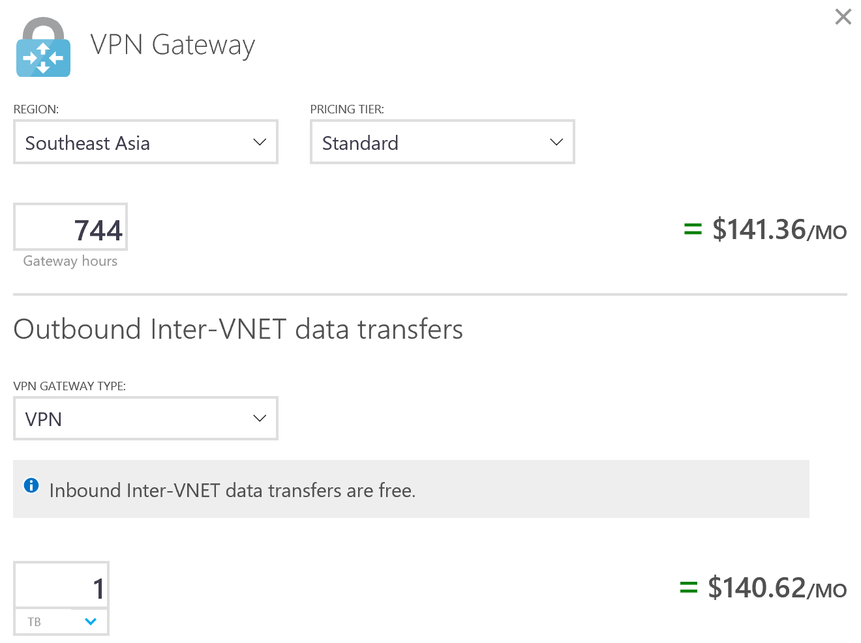
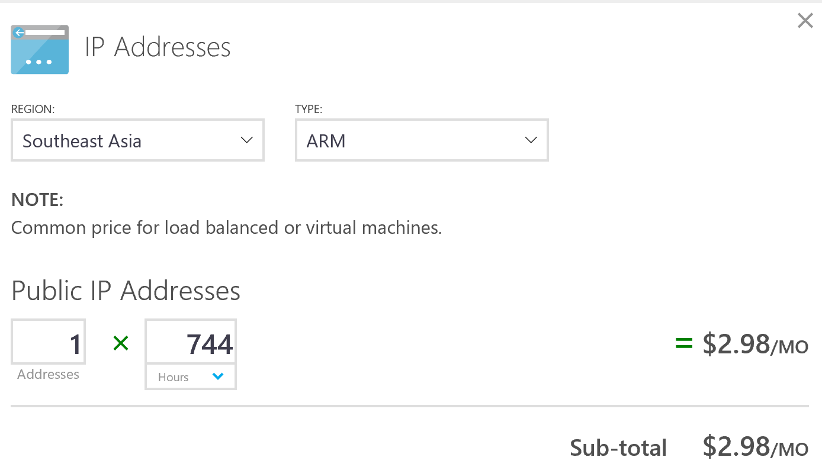
Network Services – Resources & Data Transfer (Outbound)

Slide 24
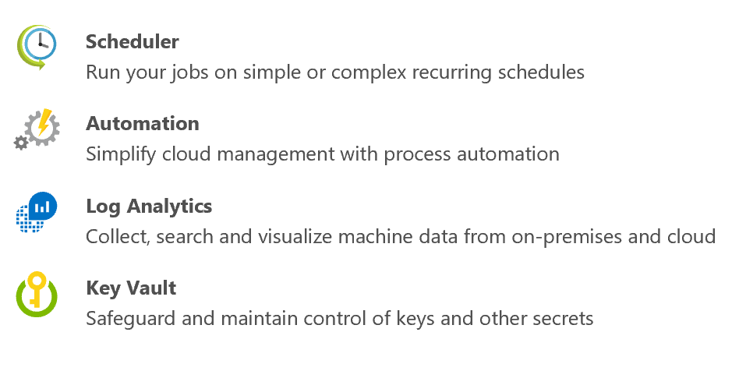
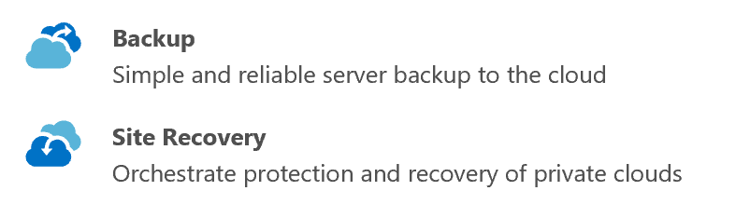



Additional Services (per Services)

Slide 25






Example : Development and Test on Azure Virtual Machine

Slide 26






Example : SharePoint on Azure Virtual Machine

Slide 27


Example : Azure Backup

Slide 28





Example : Azure Site Recovery

Slide 29
HOL : Working with Azure Resource Manager (60 minutes)
01 - Create Azure Subscription
02 – Create 3 machines to use in HOL

Slide 30
Introduction to Business Continuity and Disaster Recovery

Slide 31

Disaster Recovery as a Services
3 out of 4 companies are at risk, failing to prepare for Disaster Recovery
50% of downtime is due to hardware & software failure and human error
80% of Apps are Mission/Business critical and they are not able to meet RTO using offsite backup
DRaaS Market
$12B
Public cloud is the big disrupter that will drive democratization of DR
$1.5B
2015
2020
Markets and Markets, June 2015: http://www.marketsandmarkets.com/Market-Reports/recovery-as-a-service-market-962.html,
The Disaster Recovery Preparedness Council, “The State of Global Disaster Recovery Preparedness”, Annual Report 2014

Slide 32
Business Continuity Components
Monitoring generally means to be aware of the state of a system, to observe a situation for any changes which may occur over time
High Availability is a characteristic of a system, which aims to ensure an agreed level of operational performance for a higher than normal period
Backup
When your data is corrupted or lost, restore your data to the original location or a new location
You need all of them
No one size fit all solutions
Cost is a key concern
Disaster Recovery involves a set of policies and procedures to enable the recovery or continuation of vital technology infrastructure and systems following a operational failures, natural or human-induced disaster

Slide 33
Resiliency
Cost / Complexity
RPO / RTO
Archiving
Disaster Recovery
High Availability
RTO >> 0
RTO > 0
RTO = 0
Considerations:
Application data
Application data
Configuration data
Runbooks
Capacity
Application data
Capacity
Design work
Best For:
Data deletion
Data corruption
Legal, Governance & Compliance
Protection for unplanned failures
Don’t want to re-architect for HA
Don’t want the cost of HA
Large scale failures
Mission critical apps
New apps
Localized failures
Notes:
If you look at Resiliency, it encompasses three areas – Archiving/Backup, DR, and HA.
Each, solve different problems. Cost / Complexity vs. RPO/RTO
Archiving
DR
HA
Robust strategy encompasses on all three areas.
HA – Talk with Jason Vallery & Adam Glick on TechReadyTV.
This talk focuses on Disaster Recovery.
Transition -> How to know the difference between these?

Slide 34
High availability and disaster recovery
Disaster recovery begins where high availability ends
Virtual machine (app)
Server (app)
Availability set (HA)
Cluster (HA)
Paired region (DR)
2nd site (DR)
Notes:
DR begins where HA ends.

Slide 35
RTO and RPO
Recovery Time Objective (RTO)
“The recovery time objective (RTO) is the targeted duration of time and a service level within which a business process must be restored after a disaster (or disruption) in order to avoid unacceptable consequences associated with a break in business continuity.”, https://en.wikipedia.org/wiki/Recovery_time_objective
Recovery Point Objective (RPO)
“A recovery point objective, or “RPO”, is defined by business continuity planning. It is the maximum targeted period in which data might be lost from an IT service due to a major incident. The RPO gives systems designers a limit to work to.”, https://en.wikipedia.org/wiki/Recovery_point_objective
RPO
RTO
Disaster
Lost Data
Down Time

Slide 36
Disaster factors
Most are caused by operational failures – not natural disasters
Operational failures
Natural disasters
Human-caused events
Other
43%
31%
16%
15%
12%
13%
10%
9%
4%
3%
5%
1%
1%
1%
1%
Hurricane
Flood
Winter storm
Fire
Earthquake
Power failure
Network failure
Human error
Chemical spill
Terrorism
Other
IT hardware failure
Malicious insider
IT software failure
Malicious outsider
Source: Forrester “The State of Business Technology Resiliency Q2 2014”, May 12, 2014

Slide 37
RTO and RPO
Tier 1 / High Business Impact
Mission critical – can’t do business without
Tier 2 / Medium Business Impact
Essential apps
Tier 3 / Low Business Impact
Nice to have
Cost & Complexity
RTO/RPO
Notes:
One strategy for helping customers pick an RTO & RPO is to break the applications into categories/tiers.
Continuous replication, automated restore / failover fits more in the tier 1 – tier 2 category
Backup and restore fits more in the tier 2 – 3 category
Lower RPO/RTO => higher cost

Slide 38
Picking RPO and RTO
RPO and RTO are a business decision
Get your current RPO and RTO
Test options and estimate costs
Get business owner agreement on RPO and RTO
Implement & measure

Slide 39




Key Blocker to have BCDR in-place
Investment Cost
Operations Cost
Technologies

Slide 40
The Journey of Business Continuity and Disaster Recovery
Business Impact and Level of Protection
High
Disaster Recovery
Cloud Backup
Prevent Business Disruption:
Reduce operating expenses of maintaining a secondary datacenter
Integrated all technologies to make it work together
Data Center
Expansion
Protect critical applications data from lost:
Data growth handling
Meet regulatory long term retention (LTR) demands
Eliminate operations cost
Business Impact
Monitoring
Balancing data center operations between: Business demands vs. Cost
Computing
Storage
Security
Applications
Transaction Database Tiering
Deep visibility into your datacenter
Capacity shortages
Tracking changes
Security Risk
Avoid problems associated with configuration issues
Etc.
Low
Low
Level of Protection
High

Slide 41



The Journey of Business Continuity and Disaster Recovery
Technologies Landscape
High
Disaster Recovery
Cloud Backup
Data Center
Expansion
Azure Site Recovery
Azure Backup
Business Impact
Monitoring
Stretch Database
Database Mirroring
Always-On
VM
StorSimple
Operational Insights
Azure
IaaS, PaaS and SaaS
Low
Low
Level of Protection
High

Slide 42
Introduction to Microsoft Operational Management Suite

Slide 43


Introduction to Microsoft Operational Management Suite
Log analytics
Backup & Recovery
IT Automation
Security & Compliance
Effortless log collection
Integrated fast search and queries with custom dashboard
Integrated cloud backup
Seamless disaster recovery and workload migration
Hybrid runbook worker
Graphical workbook authoring and automation DSC
Malware assessment
Security posture and system update assessment
With OMS capabilities customers can…
Spot problems fast
Protect data easily
Automate tasks quick
Recognize threat early
extending System Center capabilities, as an all-in-one management solution!

Slide 44
Log analytics
Gain visibility across your hybrid enterprise cloud.
Deliver unparalleled insights across your datacenters and public clouds, including Azure and AWS.
Collect, store, and analyze log data from virtually any Windows Server and Linux source.

Slide 45
Deliver unparalleled insights
Easy collection, correlation, and visualization of your machine data
Insight into physical, virtual, and cloud infrastructure health, capacity, and usage
Proactive operational data analysis
Log management across physical, virtual, and cloud infrastructure
Capacity planning and deep visibility into your datacenter and across premises
Faster investigation and resolution of operational issues with deep insights
Notes:
Log management across physical, virtual, and cloud infrastructure
Separate the signal from the noise with powerful log management tools
Collect and search across multiple sources from multiple systems in a single Big Data store
Easily identify the root cause of operational issues
Capacity planning and deep visibility into your datacenter and across premises
Pinpoint capacity shortages and investigate “what-if” scenarios
Identify stale and over-allocated virtual machines
Plan your future compute and storage needs for your infrastructure
Faster investigation and resolution of operational issues with deep insights
Offer pre-built rules and algorithms that perform initial analysis
Accelerate the time to first insight

Slide 46
Security
Help secure your workloads, servers, and users. Identify missing system updates and malware status. Collect security-related events and perform forensic, audit, and breach analysis. Enable cloud-based patch management for all your environments.

Slide 47


Security and audit
Collect security related events and perform forensic, audit and breach analysis.
Security posture
Notable issues
Summary threats

Slide 48

Security Solution Pack
Security Posture
Quick glance showcasing server workload and server security threats
Computer growth change
Account authentication
Total system activities
Processes executed
Change in policy
Remote IP Tracking

Slide 49

Security Solution Pack
Notable issues
Understand notable security issues, and audit rate of change
Failed account access
Security policy and group changes
Password resets
Event log cleaning
Lock-out accounts

Slide 50







Slide 51







Slide 52
Demo : Operational Insight Dashboard

Slide 53
Automation
Orchestrate complex and repetitive operations.
Create, monitor, manage, and deploy resources
Reduce errors and boosting efficiency

Slide 54


New Automation capabilities
Built-in integration with on-premises systems and PowerShell DSC nodes.
Run Azure Automation runbooks on-premises
Automation accessible via new REST API (including GitHub, VSO and ARM)
Graphical workflow-authoring tool
Runbook Management from the new Microsoft Azure portal

Slide 55
Availability
Ensure data integrity and application availability. Backup and enable integrated recovery for all your servers and applications, no matter where they reside..

Slide 56
Cloud-enabled protection
Affordable in-box business continuity and disaster recovery solution
Seamless integration with existing backup and recovery investments
Best-in-class security and data encryption
Automated virtual machine replication
Integration of on-premises replication tools with cloud-based recovery
Security-enhanced replication of application data
Notes:
Automated virtual machine replication
Replicate your datacenter to Azure to build and manage your own secondary location
Get advanced protection for virtual machines with automatic replications
Integration of on-premises replication tools with cloud-based recovery
Get seamless integration with different replication tools such as Microsoft System Center, Hyper-V Replica, and AlwaysOn
Easily integrate cloud-based site recovery with existing SAN devices, including NetApp, HP, and EMC for better disaster recovery
Security-enhanced replication of application data
Get greater data security with encryption, whether data is at-rest or moving toward a cloud-based secondary site

Slide 57

Operations Management Suite Price
Remark : Not include other Azure Monetary Credit e.g. Compute, Storage, Network and etc.

Slide 58


Add-on components
Remark : Not include other Azure Monetary Credit e.g. Compute, Storage, Network and etc.

Slide 59
HOL : Working with Operational Insights (45 minutes)
03 - Getting Started with OMS
04 - Performing Log Analytics with OMS

Slide 60
Introduction to Azure Backup

Slide 61

Tape vs. Cloud - TCO
“Although tape media is very inexpensive, a majority of the cost of tape-based backup is the "soft" costs, which occur around backup software, maintenance and staff time”
Gartner ID:G00261961

Slide 62
Long term retention (LTR)
Business needs
Compliance/Legal
Reduce costs
}
Storage
Capacity
Azure backup
Data grows exponentially (50 – 60% Annually)
Cloud Backup Opportunity
(LTR, Offsite, DR)
1 – 100 years
90% Restores from Short-Term-Retention (30 days or less)
Tape
Local Backup
Time

Slide 63

Microsoft Azure Backup Extending Windows Server Backup into the cloud
Microsoft Azure
Reliable offsite data protection: Backups are encrypted before transmission and stored encrypted in Microsoft Azure.
Backups are off-site, away from your datacenter, protected by reliable Azure storage.
Contoso
Backup Vault
Simple, and integrated solution: Integrates with GUIs of Windows Server Backup or System Center Data Protection Manager.
Encrypted data sent to Microsoft Azure
Efficient and flexible backup and recovery: Incremental backup transfers only delta changes to the cloud.
Supports Point-in-Time Recovery of multiple versions of your data.
Configurable data retention policies, data compression, and data transfer throttling offer added flexibility and efficiency.
Windows Server instances with the Microsoft Azure Backup Agent installed and configured
Contoso Private Cloud (On-premises)

Slide 64


Azure Backup is Efficient
Customer Premises
1. Identify changed blocks
2. Compress
Efficient change tracking
Transfer only changed content
Compression for low WAN and Azure Storage consumption

Slide 65
Azure Backup is Secure
Customer Premises
1. Identify changed blocks
2. Compress
3. Encrypt
256-bit encryption
In transit and at rest
Admin owns and manages keys

Slide 66
Azure Backup is Flexible
Customer Premises
Azure Backup
1. Identify changed blocks
2. Compress
3. Encrypt
4. Encrypted data in backup vault
Daily, Weekly, Monthly, Yearly back
Choice of 16 regions and growing
Throttle network usage
Offline IR (Ship IR copy to Azure)
Protect DS of size up to 54TB

Slide 67
Azure Backup is Resilient
Customer Premises
Azure Backup
Geo-replicated copy
1. Identify changed blocks
2. Compress
3. Encrypt
4. Encrypted data in backup vault
99.9% availability
3 copies per datacenter
+ Geo-replicated copy for DR

Slide 68


Azure Backup
Customer Azure Subscription
Workload backup to Azure via SCDPM or Azure Backup Server
System Center Data Protection Manager
or
Azure Backup
Server
Azure Backup Service
File/Folder backup to Azure
Azure Backup Vault
Azure Backup
Agent
On premises – built & managed infrastructure
Cloud – flexible, remote infrastructure

Slide 69
Deployment Models
 | Characteristics
SCDPM + Azure Backup | Disk to disk to cloud backup - Faster operational recovery from disk backups (D to D to C) Requires additional server and local disks Workload backup (File/Folder, SQL, Exchange, Sharepoint, Client, Hyper-V VM, VMWare VM) Only SCDPM server needs internet connectivity Flexible backup schedule Central Backup Policy Enforcement (backup policy or encryption keys) Licensing tied to System Center Requires Azure subscription only to backup to Azure
Microsoft Azure Backup Server | Works just like SCDPM + Azure Backup except: Requires Azure subscription always Pay as you go license - tied to Azure subscription (SQL License bundled with Azure backup server) Cost effective for SMB No tape backup support Note: Can perform disk to disk backup (or) disk to disk to cloud backup - sending backup data to Azure is optional
Microsoft Azure Backup Agent (MARS agent) | No on-prem storage (D to C) No additional infrastructure needed File/folder protection only (no other workloads) Windows Servers require internet connectivity Self Service Backup and Recovery Max backups can be thrice a day and single backup policy per server No central enforcement of encryption keys or policy

Slide 70



Azure IaaS VM Backup
“Optimally protect your cloud data”
Customer Need:
Application consistent backup
Backup without shutting down VM
Protection from deletion/corruption of VM
Features
Configurations
Management
Application Consistent
No need to shutdown
Incremental backup
Long Term Retention
Restore as VM or VHD
Windows and Linux
16 disks
Load balancer
Multi NIC
Reserved IP
Built-in policies
PowerShell
Job monitoring and report
Linux
SQL Server
Premium Storage
Virtual Machines
No backup infrastructure
Self Service Backup/Restore
Backup as a Service
Pay as you go

Slide 71
HOL : Working with Azure Backup (45 minutes)
05 - Getting Started with Azure Backup

Slide 72
Agenda – Day 2
Introduction to Azure Site Recovery (75 minutes)
Introduction to Azure Site Recovery
Break
HOL : Azure Site Recovery – Part 1 (60 minutes)
Create Azure Site Recovery Vault
Azure Site Recovery Process Server Installation
Enabling Azure Site Recovery Protection Machine
Creating Azure RemoteApp
Lunch
HOL : Azure Site Recovery – Part 2 (90 minutes)
Verify Protection Status
Performing Test-Failover
Performing Unplanned Failover
Create VNET connection between RemoteApp to ASR Test-Failover VNET
Break
HOL : Configuring Automation
HOL : Enabling RemoteApp
Working with Azure Starter Kits (60 minutes)
Post Bootcamp Examination

Slide 73
Introduction to Azure Site Recovery

Slide 74

Safeguard your customer’s applications On-premises to Microsoft Azure protection with Azure Site Recovery
Microsoft Azure Site Recovery
Microsoft Azure Site Recovery
Orchestration & Replication
Communication Channel
vCenter /Physical
vCenter /Physical
Replication channel:
Primary Site
Windows Server
Windows Server
Primary Site
Recovery Site
Windows Server
Support for heterogeneous environments
No-impact recovery plan testing
Orchestrated recovery of tiered applications
Key features include:
Use Azure as your DR site
Automated VM protection & replication
Remote health monitoring
Customizable recovery plans
Notes:
Now as we talked in a DR project setting up and managing secondary site is the primary cause of cost and complexity. So with Azure Site Recovery we released another DR scenario where you don’t need to setup a secondary site for DR – instead you can leverage Azure as your DR site. Our customers love this as this opens up so many opportunities for DR – so many new customers and applications can now afford DR. Today we have this scenario available for Hyper-V workloads and this year we are also enabling this for Vmware/physical workloads.
For both OnPrem to OnPrem as well as OnPrem to Azure we provide the same DR management value prop for our customers.

Slide 75







Azure Site Recovery: The disaster recovery / migration solution
Site to Azure
Site to site
Any cloud
AWS
Physical/VMware to VMware
VMware
Hyper-V
Physical
VMM to VMM
Windows
Linux
Notes:
Markettecture for ASR
site to azure
VMWare
Hyper-V
physical
config - network & disk
on-prem to azure
migrate from AWS or any cloud to Azure
Azure to Azure still coming in the future
Customers with two data centers & a need to stay in those for compliance or other reasons.
DR between two sites
physical VMware
VMM to VMM
Support for Windows or Linux

Slide 76
Azure Site Recovery: The Complete Disaster Recovery Solution
OMS
Part of a Broader Cost Effective Management Story
Any Cloud
VMWARE, HYPER-V, Physical, AWS*
DR to Azure
DR to Alternate Site
+
Any OS
Windows
Linux
App Aware
SharePoint | SQL Server | Exchange | SAP | Oracle | and more..
Cloud On-Ramp
Disaster Recovery | Migration| Dev/Test
Power of Azure
Hyper-Scale| Enterprise Grade | Hybrid | Agile
Notes:
Have first slide that Dr is important
Is there data on backup customers who use backup of DR.
How much is currently covered by DR products
Show the market size
Refer to SRM quotes on DR vs. backup
Quote Levi’s /chevron
Add a slide on Power of Azure
Show single slide showing Any to Any (Add Windows/Logo)
App workload, talk up MS support, show logo
Add partner slide
Get Karl: inputs on what succeeds
Where is it easy to make sale
Top objection handling
Sweet spot for selling
Where to go for more information and support
http://bcdr
Ryan: Call for action
Expand the backlog slide

Slide 77
DR is not selling Azure Site Recovery. DR is a consulting & strategy engagement.
Notes:
Turn it over to Adam to wrap up.

Slide 78



Disaster Recovery Scenario – Put the all together
Azure Automation
Automate complex tasks on Post-Recovery process
DR Orchestration
Azure Site Recovery
DR Orchestration
SQL Backend
IaaS VM
SQL Availability Group
App Tier
- Front End
- Standalone
ASR Replication
Azure Storage
Azure Backup Replication
Azure AD
Domain Services
Active Directory
Azure AD Domain Services
Storage
StorSimple Snap-Shot
StorSimple VM
S2S VPN
Azure
Primary Site
Notes:
Another common hero scenario is where a customer is using SQL Always-ON for DB DR. We have worked with SQL PG to enable single click Application failover using ASR. Here SQL replication is used to replicate SQL DB changes to Azure IaaS VM running SQL Always On. However for Web and App Tier either replica or Scout channel is used to replicate changes.
Using both these hero scenarios we can do DR for any workloads – I’ll be doing a deep-dive on workloads

Slide 79


ASR DR to Azure scenarios architecture
vCenter
_{(Optional)}
Process & Config Server
VMware VMs & Physical Servers
VMM
_{(Optional)}
Azure Site Recovery Vault
Hyper-V VMs
Process Server – Used for Discovery, Caching, Compression & Encryption
ASR Provider – Captures all data writes from memory or VHD differencing disk

Slide 80
Deployment Best Practices
Use new ASR Capacity Planning tool to plan deployments:
Estimate size and number of on-prem PS VMs based on VM churn rate
Estimate Storage account requirements
Estimate Network bandwidth requirements – Leverage ExpressRoute
Use Legacy to Enhanced migration feature to move existing customers to eV2A solution
Understand and configure proxy settings for ASR components to talk to internet
Understand VMware requirements:
VSphere 6.0, 5.5, 5.1
Credentials used to connect should have write permissions for failback operations
Failback Master Target Host should have line of site to VMs Datastores

Slide 81
Deployment Best Practice
Leverage ASR Recovery plan extensibility to address Azure limitations
Example: 1 TB Disk limit, Guest clusters, Physical configurations/UEFI - These are either DB or File Server workloads.
For Large SQL DB workloads use SQL Server Always On with SQL IaaS VM in Azure
For Large Oracle DB workloads use Data guard for Oracle Servers to replicate databases to Azure IaaS VM
For file server workloads use ASR + StorSimple integration
Orchestrate end to end using ASR Recovery Plans

Slide 82
VM to Azure | Typical Replication Steps
Protected VM
Initial Replication Reads
Track data Changes
On-Premises PS
Upload Changes
Cache
Upload Changes
Cache
Apply to target VHDs
ASR service on Azure

Slide 83

Protection lifecycle

Slide 84

Replication Data on Azure Storage

Slide 85

Checksums

Slide 86

Differential Replication
Watch the “hrl” folder created in the container for that particular replicated item which caches the differentials.
This is the backlog for this VM protection. This also will have the changes that are applied but yet to be pruned.

Slide 87

IR/Resync Dataflow from Protected VM to PS Cache
From process explorer we can see Processes on protected VM
Cache volume on Process server that has IR files replicated from protected VM

Slide 88

Replication Processes on Protected VM
View from Process explorer
Only one s2.exe process will run on a protected VM that replicates differentials on all volumes from that server
Notice two dataprotection.exe processes running for each disk that is in IR

Slide 89

Data received and sent to Azure storage
View from Resource Monitor
Cxps.exe process receiving all the replicated data from protected VMs
Cbengine.exe replicating all the processed data to Azure storage
Watch out for latencies as this will indicate if network is bad

Slide 90

Differential Data sent from Protected VM
IR is complete for all disks and so dataprotection.exe is NOT running. Only S2.exe working on DR
View from Process explorer

Slide 91

ASR Capacity Planner
https://azure.microsoft.com/en-us/documentation/articles/site-recovery-capacity-planner/
Quick or Detailed mode
Single or Multiple Machines
Are you REALLY prepared?
Additional opportunities – ExpressRoute, etc.
Notes:
Hyper-V capacity planner tool is deprecated and not longer supported.

Slide 92

How much bandwidth is getting consumed?

Slide 93
ASR DR to Azure Replication and Recovery Point
T1 - Initial Replication
T2 - Completed Replication
T3 - Incremental Replication
T4 - Incremental Replication
Full Machine Image
1 – 2 days
RPO
System Outage
Day 2 Change
Delta Rep
Day3 Change
Delta Rep
Bandwidth
Requirement
Latest Machine Stage

Slide 94






Protection & Failover Steps
Protection & Failover Steps
Create a Recovery Services Vault
Install & Register On-premises Software
Add VCenter Server
Create & Associate a Replication Policy
Replicate Virtual Machines
Configure VM properties/Network
Perform Test Failover
Create Recovery Plan & Failover
Configure re-protection & Failback

Slide 95

Enhanced VMware to Azure: Replication to Azure
^{NEW} Process Server Port and DVAACP are now configurable
^{NEW} All communication is default HTTPS

Slide 96

Enhanced VMware to Azure: Replication from Azure
^{NEW} With Azure ExpressRoute, on-premises Process Server can be used as well
^{NEW} Optionally deploy additional Process Server in Azure

Slide 97
Enabling verbose logging for replication issues
MARS Agent logs
Event Viewer logs:
E2A:
Hyper-V-VMMS
MicrosoftAzureRecoveryServices-Replication
V2A
MicrosoftAzureRecoveryServices-Replication
CBEngine*.errlog
Default log level for normal and critical events
VERBOSE set reg key: "TraceLogLevel"=dword:000005ff under [HKEY_LOCAL_MACHINE\SOFTWARE\Microsoft\Windows Azure Backup]
Restart OBEngine service for these changes to take effect
Unset this reg key after use because it causes performance degradation

Slide 98
How to troubleshoot Azure Recovery Services
For On-premises to On-premises protection
Run the following PowerShell command to collect Hyper-V logs: wevtutil el | findstr /i hyper-v-vmms | % { wevtutil qe $_ /f:text}
For On-premises to Azure protection
Run the following PowerShell command to collect Hyper-V logs: wevtutil el | findstr /i microsoftazurerecoveryservices-replication | % { wevtutil qe $_ /f:text}
Collect all the log files in the following location: C:\Program Files\Microsoft Azure Recovery Services Agent\Temp

Slide 99
How to troubleshoot Azure Recovery Services (cont.)
How to troubleshoot on VMM server
Collect the VMM debug logs (event trace log) and SRS logs that are additional information to this channel. See the detail of how to enable debug logging in Virtual Machine Manager. For Branch to Azure ASR installations, refer to KB 3033922 instead.
Run the following Windows PowerShell commands to filter and therefore narrow the scope of the investigation: Get-SCVirtualMachine Get-SCVMHost Get-VMReplication Get-SCJob
Collect Disaster Recovery Adapter (DRA) logs in the following location: %System Root%\ProgramData\VMMLogs\DRALogs

Slide 100


Azure Site Recovery Job Export

Slide 101

Azure Site Recovery Support Diagnostics Platform tool (SDP)
http://aka.ms/asrsdp

Slide 102
HOL : Azure Site Recovery – Part 1 (60 minutes)
06 - Getting Started with Azure Site Recovery
07 - Replicate applications
09 – Enabling RemoteApp

Slide 103
HOL: Azure Site Recovery – Part 2 (90 minutes)
08 - Test the deployment

Slide 104
HOL: Configuring Automation
09 – Configuring Automation

Slide 105
HOL: Enabling RemoteApp
10 – Enabling RemoteApp

Slide 106
Working with Azure Starter Kits (60 minutes)

Slide 107




Starter Kit - Archiving and Backup
The Problem:
As an IT Administrator, you need to know that the physical infrastructure is strong enough to support the users and has a backup system in case of an emergency.
For any business, the data loss may be crucial and many companies never recover the information after an unplanned event or an emergency.
In Summary the data protection challenges are:
Rapid Data Growth
Operational Challenges
Cost
Microsoft Solution
The integration of Microsoft Azure, System Center and/or Windows Server you could enable a cloud based data backup solution. With Microsoft Azure Backup you can deliver business continuity benefits by providing a backup solution that requires no initial hardware costs other than a broadband Internet connection.
Azure Backup is a multi-tenanted Azure service that enables you to back up your data present anywhere: on-premises or in Azure. It replaces your existing on-premises or offsite backup solution with a reliable, secure and cost competitive cloud based offering
Microsoft Azure Pricing:
Protecting instances, price per month:
Up to 50Gb of data = $5
Between 50GB to 500 GB of data = $10
Greater than 500GB of data = $10 for each 500GB
+ storage consumed
Storage choices, price per month example:
Locally Redundant (LRS): 1TB = $24
Geographically Redundant (GRS): 1TB = $48
Scenario: 5 Instance (450 GB Size) + 5 TB backup storage consumed
Total U$3,848.76 / Yr
39 Azure Monetary Commitment in OPEN SKU’s
High Level Architecture*
Azure Backup
Windows Server/ Windows Client/
SQL Server
Pricing and Purchase Guidance Reference
Request full version of Azure Starter Kits online through MPN
*More Detail & Components– Starter Kit Archiving and Backup IP-
Notes:
Speaker Notes:
2-3 minutes
This scenario is to set the context of saving money using IaaS. Introduce Contoso (the SMB customer that will be used in the course scenarios) as a customer that want to save money and improve agility and efficiency by integrating Azure services into its infrastructure. This scenario helps the partner see how to compare the cost of on-premises infrastructure with Azure Infrastructure. The end result will be a cost/virtual machine.
Contoso, an SMB customer, is running two datacenter servers on premises and is getting ready to upgrade to Windows Server 2012 R2. Contoso hosts 7 medium-size virtual machines (3-4 GB RAM) on average. The first server runs Hyper-V on Windows Server 2008R2 and hosts the workloads, the second server runs AD DS, DNS, email, web, intranet, backup, and so on. The motivation for moving the two servers to the cloud is saving money on IT costs by using cloud services.
The partner calculated an average monthly cost for procurement and operating expenses of two new datacenter servers over a two-year period. Each server would have dual quad-core processors, 16GB RAM, RAID controller, 5 hard disks, dual redundant power supplies, 2 years of maintenance, and Windows Server 2012 Standard as the operating system. Facility costs per server (power, cooling, datacenter space, property taxes, facility and security personnel, and other expenses related to physical infrastructure) were estimated and added to the total.
Two servers and operating system: $10,000 per server
CALs: $10,000
Two years of facility operating costs: $10,000
On-premises backup solution with support for cloud archiving: $2,800 with agents
The total procurement and operating costs total about $32,800 / 24 months = ~$1333.33 /month for two datacenter caliber servers. With 7 small virtual machines, this comes out to ~ $1,90.47 per virtual machine per month.

Slide 108
Starter Kit – Azure Site Recovery
The Problem
As an IT Administrator, you need to assure the continuity of the operations on the company and prepare a Disaster Recovery Plan in case of an emergency. An information technology disaster recovery plan (IT DRP) should be developed in conjunction with the business continuity plan.
Business Continuity Challenges:
Need to reduce the costs related to downtime
Disaster recovery solutions with synchronous replication are expensive
Manual recovery of the many virtual machines that compose services can be complex and time-consuming - procedures need to be documented and tested
Microsoft Solution
In response to many customer requests for DR on Microsoft Azure, Microsoft developed Azure Site Recovery (ASR), which enables the failover of Hyper-V and VMware VMs, as well as physical instances that are running on-premises to Microsoft Azure.
Azure Site Recovery protects mission-critical applications with automated replication-based DR of physical and virtual machines. Servers can be protected to targets that are on-premises, at a hosting service provider, or on the Azure cloud.
Microsoft Azure Pricing
High Level Architecture*
 | Price For First 31 days | Price After 31 days
Azure Site Recovery to customer owned sites | Free | $16/month per instance protected
Azure Site Recovery to Azure | Free | $54/month per instance protected
Microsoft Azure Site Recovery
On- premise to On-premise
:
Primary Site
Recovery Site
Scenario DR – Protecting to Azure:
U$ 162/Month – 3 VMs Site Recovery
U$ 65.60/Month – 700 GB Storage
U$ 66.96/Month – VM A1/744 Hours
U$ 27/Month – VM A3/75 Hours
U$ 26.78/Month - VPN
Total U$ 4185.35/Year
42 Azure Monetary Commitment in OPEN SKUs
Microsoft Azure Site Recovery
On- premise to Microsoft Azure
Orchestration & Replication
Primary Site
Pricing and Purchase Guidance Reference
Request full version of Azure Starter Kits online through MPN
*More Detail & Components– Starter Kit Archiving and Backup IP
Notes:
Speaker Notes:
2-3 minutes
This scenario is to set the context of saving money using IaaS. Introduce Contoso (the SMB customer that will be used in the course scenarios) as a customer that want to save money and improve agility and efficiency by integrating Azure services into its infrastructure. This scenario helps the partner see how to compare the cost of on-premises infrastructure with Azure Infrastructure. The end result will be a cost/virtual machine.
Contoso, an SMB customer, is running two datacenter servers on premises and is getting ready to upgrade to Windows Server 2012 R2. Contoso hosts 7 medium-size virtual machines (3-4 GB RAM) on average. The first server runs Hyper-V on Windows Server 2008R2 and hosts the workloads, the second server runs AD DS, DNS, email, web, intranet, backup, and so on. The motivation for moving the two servers to the cloud is saving money on IT costs by using cloud services.
The partner calculated an average monthly cost for procurement and operating expenses of two new datacenter servers over a two-year period. Each server would have dual quad-core processors, 16GB RAM, RAID controller, 5 hard disks, dual redundant power supplies, 2 years of maintenance, and Windows Server 2012 Standard as the operating system. Facility costs per server (power, cooling, datacenter space, property taxes, facility and security personnel, and other expenses related to physical infrastructure) were estimated and added to the total.
Two servers and operating system: $10,000 per server
CALs: $10,000
Two years of facility operating costs: $10,000
On-premises backup solution with support for cloud archiving: $2,800 with agents
The total procurement and operating costs total about $32,800 / 24 months = ~$1333.33 /month for two datacenter caliber servers. With 7 small virtual machines, this comes out to ~ $1,90.47 per virtual machine per month.

Slide 109

© 2015 Microsoft Corporation. All rights reserved. Microsoft, Windows, and other product names are or may be registered trademarks and/or trademarks in the U.S. and/or other countries.
The information herein is for informational purposes only and represents the current view of Microsoft Corporation as of the date of this presentation. Because Microsoft must respond to changing market conditions, it should not be interpreted to be a commitment on the part of Microsoft, and Microsoft cannot guarantee the accuracy of any information provided after the date of this presentation. MICROSOFT MAKES NO WARRANTIES, EXPRESS, IMPLIED OR STATUTORY, AS TO THE INFORMATION IN THIS PRESENTATION.

